Slide 1

Homework 6 Privacy INT4023
Dalton Murray

Slide 2
Information

Slide 3
Personally Identifiable Information (PII) & Personal Health Information (PHI)
Patient Names, Relative’s names, Mother’s maiden name
Geographical Elements (Street address, city, country, zip code), place of birth
Birthdates, dates of admission, date of discharge, date of death, exact age
Telephone number
Fax numbers
Email addresses
Social Security Numbers
Medical record numbers
Health insurance beneficiary numbers
Digital identifiers, website urls
IP addresses
Biometric elements, finger, retinal, voice
Full face photographs
Driver’s license number
Bank account information
Credit card information
Personal characteristics
Passport information
Vehicle identifiers, serial numbers

Slide 4
Automatic Search - Website

Slide 5
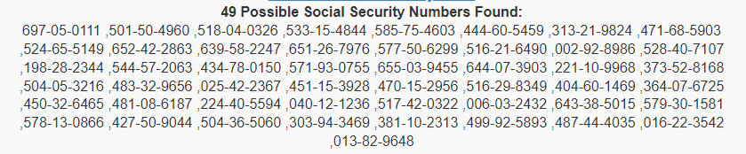
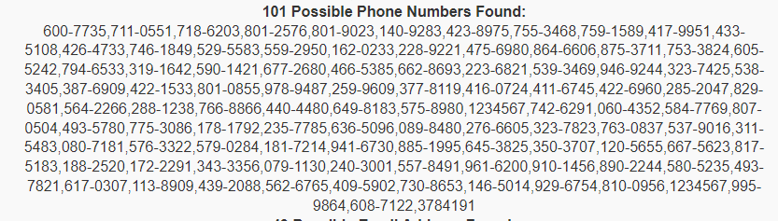
Automatic search results

Slide 6
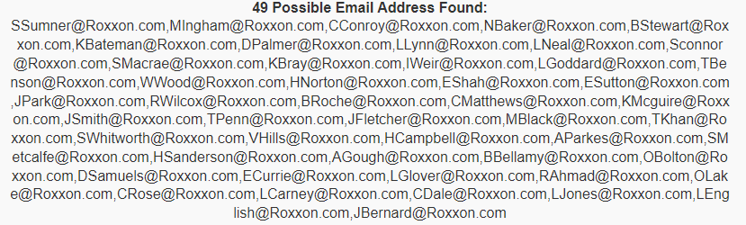
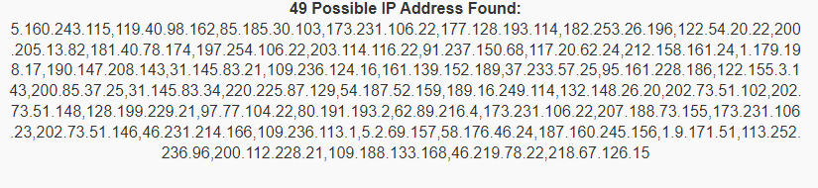
Automatic search results

Slide 7
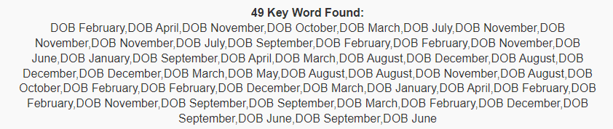
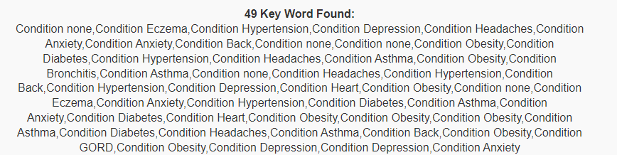
Custom search results

Slide 8
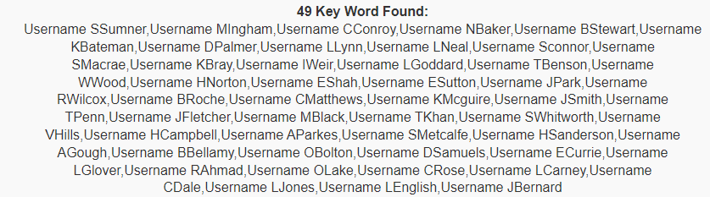
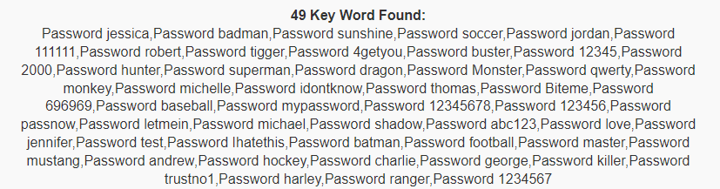
Custom search results

Slide 9
Automatic Search - Software

Slide 10
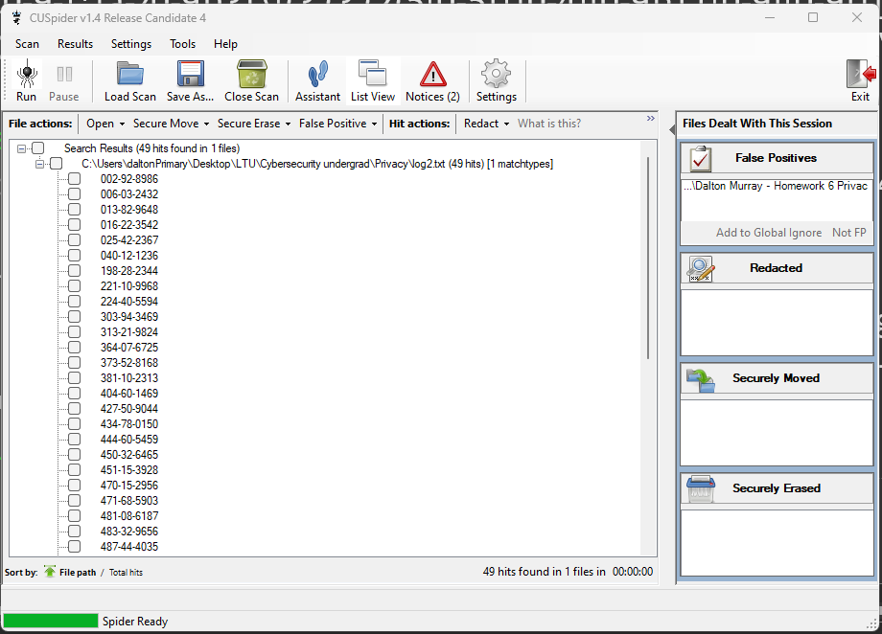
CUSpider

Slide 11
Manual Search

Slide 12
RegEx
SSN - ?!(000|666|9))\d{3}-(?!00)\d{2}-(?!0000)\d{4} – 49 results
Phone number - (\+\d{1,2}\s?)?\(?\d{3}\)?[\s.-]?\d{3}[\s.-]?\d{4} – 49 results
Email - (?:[a-z0-9!#$%&'*+/=?^_`{|}~-]+(?:\.[a-z0-9!#$%&'*+/=?^_`{|}~-]+)*|"(?:[\x01-\x08\x0b\x0c\x0e-\x1f\x21\x23-\x5b\x5d-\x7f]|\\[\x01-\x09\x0b\x0c\x0e-\x7f])*")@(?:(?:[a-z0-9](?:[a-z0-9-]*[a-z0-9])?\.)+[a-z0-9](?:[a-z0-9-]*[a-z0-9])?|\[(?:(?:(2(5[0-5]|[0-4][0-9])|1[0-9][0-9]|[1-9]?[0-9]))\.){3}(?:(2(5[0-5]|[0-4][0-9])|1[0-9][0-9]|[1-9]?[0-9])|[a-z0-9-]*[a-z0-9]:(?:[\x01-\x08\x0b\x0c\x0e-\x1f\x21-\x5a\x53-\x7f]|\\[\x01-\x09\x0b\x0c\x0e-\x7f])+)\])
- 49 results
IPv4 - (?:(?:25[0-5]|2[0-4][0-9]|[01]?[0-9][0-9]?)\.){3}(?:25[0-5]|2[0-4][0-9]|[01]?[0-9][0-9]?) – 49 results
a
DOB/Date - (Jan(uary)?|Feb(ruary)?|Mar(ch)?|Apr(il)?|May|Jun(e)?|Jul(y)?|Aug(ust)?|Sep(tember)?|Oct(ober)?|Nov(ember)?|Dec(ember)?)\s+\d{1,2},\s+\d{4} – Month Day, Year format – 49 results
Patient - (.*patient.*) – 49 results
Username - (.*username.*) – 49 results
Password - (.*password.*) – 49 results

Slide 13
Recommendations

Slide 14
How
PII scanner through provided website
Automated tools such as CUSpider
Custom RegEx’s
I was able to find:
Update case numbers
Full name
Username
Password
Gender
Phone
IPv4
Full address
Conditions
Patient record numbers
Emails
Example: Entry U00480. User Request: update 697-05-0111 , Sherell Sumner , Username SSumner , Password jessica , female , Phone (988) 600-7735 , 5.160.243.115 , 1621 Crystal Common, Redwood Lodge, North Dakota, 58711-0551, US, 39.4411, -123.689 , DOB February 23, 1994 , Condition none , Link NA , Patient-Record C-08148 , SSumner@Roxxon.com

Slide 15
What next?
Properly encrypt/hash all PII and PHI
2FA/MFA
Only keep what is needed
Store in secure areas
Limit access
Policy
Inform affected people immediately
Have a plan to fix – take responsibility

